Slide 1
Week 1
Winter Break
TA Meeting time set
ARLISS Team meeting time undecided

Slide 2
Week 2
Met with TA
Set what Alpha version would look like
Need to make simulators for testing

Slide 3
Week 3
First ARLISS Team meeting of the term
Control board set
Wheel system under development
Continued progress on alpha release

Slide 4
Week 4
Client was present at team meeting
Change to obstacle avoidance module
Change won’t be applied until after alpha release

Slide 5
Week 5
Continued work on obstacle avoidance module
Edits made to tech review and design document

Slide 6
Week 6
Write progress report
Short team meeting
Rover frame broke during testing

Slide 7
Control Board
Using Raspberry Pi Zero
Meets size constraints
Still powerful enough to run our software

Slide 8
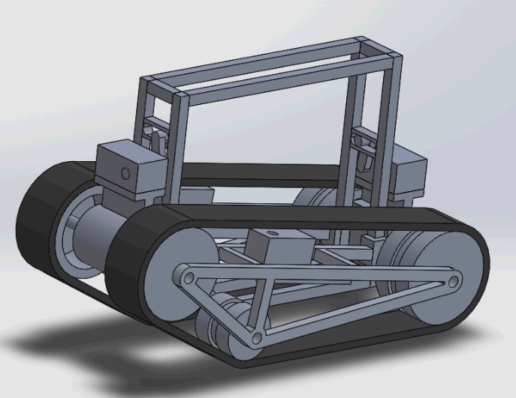
Wheel System
Designed and built by ME team
Three wheel caterpillar track
Hasn’t been built yet

Slide 9
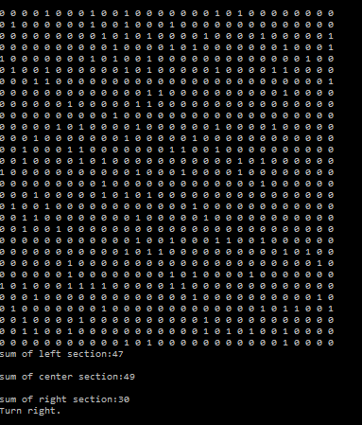
Obstacle Avoidance
Takes Zach’s image conversion as input
Split into three “lanes”

